Slide 1
Gavilan Community College District
Educational Master Plan (EMP)
Overview Presentation
November 15, 2016
Cambridge West Partnership, LLC

Slide 2
Cambridge West Partnership
C.M. Brahmbhatt
  Senior Partner and Manager
Joyce Black
  Senior Partner and Project Leader
Fred Trapp
  Senior Associate
Austin Dike
  Associate
The Team

Slide 3
Our Experience
Participated in the development of over 20 Educational/Facilities Master Plans and 5 Educational Centers
Support for Accreditation and Educational Master Planning
Experienced in Bond Development and Planning
Preparation of 5YCP, Report 17, IPP’s & FPP’s
Excellent Reputation at the Chancellor’s Office
Have qualified over $600 million for State Funding
The Team

Slide 4
Community College Districts We Served
San Jose-Evergreen (San Jose City, Evergreen Valley)
City College of San Francisco
Kern (Porterville, Bakersfield, Cerro Coso)
Coast (Coastline, Golden West, Orange Coast)
Antelope Valley
Victor Valley
Barstow
Palo Verde
Long Beach
Mt. San Antonio
Cerritos
North Orange County (Fullerton, Cypress, School of Continuing Education)
Rancho Santiago (Santa Ana, Santiago Canyon, Noncredit Centers)
Palomar
Southwestern
The Clients

Slide 5
Guiding Principles
All campus planning begins with the program of instruction.
Planning must be built with and be supported by the college community.
All plans must be integrated into a unified whole supporting the college’s strategic plan.
Public policy and labor market data present opportunities.
approach

Slide 6
College Steering Committee
Dr. Peter Wruck, Co-chair
Dr. Randy Brown, Co-chair
Carina Cisneros, Administrator
Noemi Naranjo, Professional Support Staff
Linda Bernabe, Supervisor/Confidential
Scott Sandler, Faculty
Marisol Arredondo, Student

Slide 7
Project Web Page
Intranet
  https://mail1.gavilan.edu/emp/

Slide 8
Importance of the
Educational Master Plan
Required
  Title 5, section 51008- Academic Master Plan
Expected
  ACCJC accreditation activities now “look for” an EMP as part of integrated planning.
Role of the EMP
  Frames a discussion to guide the future of the educational programs and student services.
  Supports planning for future capital construction and the Facilities Master Plan.

Slide 9
Project Scope
The Gavilan College Educational Master Plan is…
  the foundation for planning to meet the instructional and support service needs of Gavilan College
  the basis for Gavilan College’s capital, facilities, technology, personnel and budget plans.
  part of an integrated planning model and dynamic in nature intended to be reviewed periodically as new educational trends emerge and the needs of students and the district evolve.

Slide 10
Project Objectives
To create a vision for future educational program offerings.
To keep pace with and anticipate the changing needs of the students and communities served by the college.
To encourage consideration of alternative strategies for delivering instruction.
To provide guidance for creating a balanced curriculum.

Slide 11
Project Objectives
Foundation for other planning
To serve as a decision-making tool and reference for the future.
To link the college vision and mission to the planning process.

Slide 12
Core Questions
1. What might be the curriculum options for the College to match labor market needs, transfer opportunities, and community educational needs/interests?
2. How much additional or modified instructional and student services space might the College need in the future?
approach

Slide 13
Three Levels of Planning
Institutional (long range)
  EMP, FMP, Strategic Plan
Functional (middle range)
  See next slide
Unit (short range)
  Program review, department/discipline, service area

Slide 14



EMP is Not…
The same as a functional-level plan
  Technology
  Student Success and Support Program
  Student Equity
  Distance Education
  Deferred Maintenance
  Enrollment Management
  Outreach & Recruitment
  Disaster Preparedness
  Professional Development

Slide 15
EMP Overview
Message from President
Introduction
College History & Overview
Mission, Vision, Values
Environmental Scan
  External
  Internal
Institutional Effectiveness
Planning Assumptions, Strategic Priorities, & Goals
Opportunities for the Future
Projections for the Future Growth

Slide 16
EMP Process
Selection- Oct 2016
Fall 2016*
  Data collection and analysis
  Kick off meeting
  Questionnaire and Interviews
  Presentations to steering committee, Academic Senate, Student Government
Spring 2016*
  Interviews
  Presentations to steering committee
  Open house
  Board presentation (April)
*email and phone exchanges throughout

Slide 17
Data Collection Strategy
Define College Visions, Needs, Expectations
  Questionnaire
  Group Interviews
    Deans and faculty
    Directors and staff
    Student Leadership
  College Plans, Research Reports, and Data
    See annotated required resources list
    MIS Referential Files and Data Mart
  Progress Reviews and Open Forums
Extensive Use of External Data, Studies, and Research
approach

Slide 18
EMP Approach
External Scan
  Higher Education Public Policy
  Economic Trends
  Student Origins
    Assessment of the College Effective Service Area
Data from the college
  Access to MIS Referential Files (ST, SX, SG, XF, SP)
    Fall 2010-2015
    Annual Awards 2010-11 to 2015-16
approach

Slide 19
EMP Approach
approach
Internal Scan
  Overall Headcount and Enrollment History
  Student Characteristics
  Analysis of the Program of Instruction
  Non-instructional Resources to Support the Program of Instruction
Data from the college:
  List of locally approved certificates
  College goals and priorities
  2005 to 2015 fall term only 1st census enrollment counts
  2011-2015 fall term only WSCH and WSCH equivalent totals
  Fall 2015 schedule file (excel spreadsheet and PDF)
  Master room assignment list
  Curriculum structure list (subject abbreviations related to divisions)
approach

Slide 20
EMP Approach
approach
Key Planning Assumptions, Strategic Priorities/Goals
Opportunities for the Future
  Faculty and Student Services Future Visions (questionnaire and interviews)
    Summarized highlights
  Labor Market Data Analysis
  Potential New Programs or Directions
  Opportunities for Improvement and Expansion

Slide 21
EMP Approach
approach
Projections for the Future
  Past History of Growth
  Fall Terms
    Weekly Student Contact Hours (WSCH)
  Effective Service Area Demographics
    College Age or Career Choice (18-24 years of age)
    Young Adult or Career Starter (25-34 years of age)
    Ethnicity
    Educational Attainment, age 25 or older
  Participation Rates

Slide 22
EMP Approach
approach
Baseline Term- Fall 2015
  Section-level data
    Segment by location
    Account for online offerings
    Consider combined classes
    By discipline distinguish lecture from laboratory
    Summarize WSCH by discipline
Projections for the Future
  Future Capacity for Growth
    WSCH growth as applied to the future program of instruction
    For each division, department, discipline
      Apply the growth rate to WSCH in the baseline
      Calculate in five-year increments out to 2030

Slide 23

EMP Approach
Translating
  For each division, department, discipline convert projected WSCH to
    Estimated number of sections
    Estimated Assignable Square Footage (ASF) and number of rooms
  Apply State space use standards
  Apply instructional management experience
approach

Slide 24
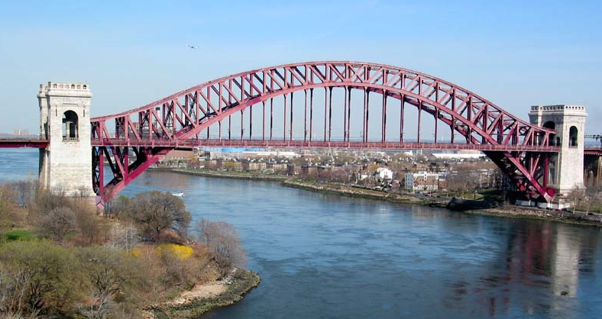
EMP Approach
Space Implications for Facilities Master Plan
  Current instructional room assignments & ASF
  Convert Weekly Student Contact Hours into Space
    By discipline
    Using State space standards
approach

Slide 25

Discussion
Questions and Answers

